Slide 1
Chapter 16: Recovery System

Slide 2
Chapter 16: Recovery System
Failure Classification
Storage Structure
Recovery and Atomicity
Log-Based Recovery
Shadow Paging
Recovery With Concurrent Transactions
Buffer Management
Failure with Loss of Nonvolatile Storage
Remote Backup Systems

Slide 3
Failure Classification
Transaction failure :
  Logical errors: transaction cannot complete due to some internal error condition
  System errors: the database system must terminate an active transaction due to an error condition (e.g., deadlock)
System crash: a power failure or other hardware or software failure causes the system to crash.
  Fail-stop assumption: non-volatile storage contents are assumed to not be corrupted by system crash
    Database systems have numerous integrity checks to prevent corruption of disk data
Disk failure: a head crash or similar disk failure destroys all or part of disk storage
  Destruction is assumed to be detectable: disk drives use checksums to detect failures

Slide 4
Recovery Algorithms
Recovery algorithms are techniques to ensure database consistency and transaction atomicity and durability despite failures
  Focus of this chapter
Recovery algorithms have two parts
  Actions taken during normal transaction processing to ensure enough information exists to recover from failures
  Actions taken after a failure to recover the database contents to a state that ensures atomicity, consistency and durability

Slide 5
Storage Structure
Volatile storage:
  does not survive system crashes
  examples: main memory, cache memory
Nonvolatile storage:
  survives system crashes
  examples: disk, tape, flash memory,
  non-volatile (battery backed up) RAM
Stable storage:
  a mythical form of storage that survives all failures
  approximated by maintaining multiple copies on distinct nonvolatile media

Slide 6
Data Access
Physical blocks are those blocks residing on the disk.
Buffer blocks are the blocks residing temporarily in main memory.
Block movements between disk and main memory are initiated through the following two operations:
  input(B) transfers the physical block B to main memory.
  output(B) transfers the buffer block B to the disk, and replaces the appropriate physical block there.
Each transaction T_{i} has its private work-area in which local copies of all data items accessed and updated by it are kept.
  T_{i}'s local copy of a data item X is called x_{i}.
We assume, for simplicity, that each data item fits in, and is stored inside, a single block.

Slide 7
Data Access (Cont.)
Transaction transfers data items between system buffer blocks and its private work-area using the following operations :
  read(X) assigns the value of data item X to the local variable x_{i}.
  write(X) assigns the value of local variable x_{i} to data item {X} in the buffer block.
  both these commands may necessitate the issue of an input(B_{X}) instruction before the assignment, if the block B_{X} in which X resides is not already in memory.
Transactions
  Perform read(X) while accessing X for the first time;
  All subsequent accesses are to the local copy.
  After last access, transaction executes write(X).
output(B_{X}) need not immediately follow write(X). System can perform the output operation when it deems fit.

Slide 8
Example of Data Access
buffer
Buffer Block A
input(A)
X
A
Buffer Block B
Y
B
output(B)
read(X)
write(Y)
work area of T₁
x₂
work area of T₂
x₁
y₁
memory
disk

Slide 9
Recovery and Atomicity
Modifying the database without ensuring that the transaction will commit may leave the database in an inconsistent state.
Consider transaction T_{i} that transfers $50 from account A to account B; goal is either to perform all database modifications made by T_{i} or none at all.
Several output operations may be required for T_{i} (to output A and B). A failure may occur after one of these modifications have been made but before all of them are made.

Slide 10
Recovery and Atomicity (Cont.)
To ensure atomicity despite failures, we first output information describing the modifications to stable storage without modifying the database itself.
We study two approaches:
  log-based recovery, and
  shadow-paging
We assume (initially) that transactions run serially, that is, one after the other.

Slide 11
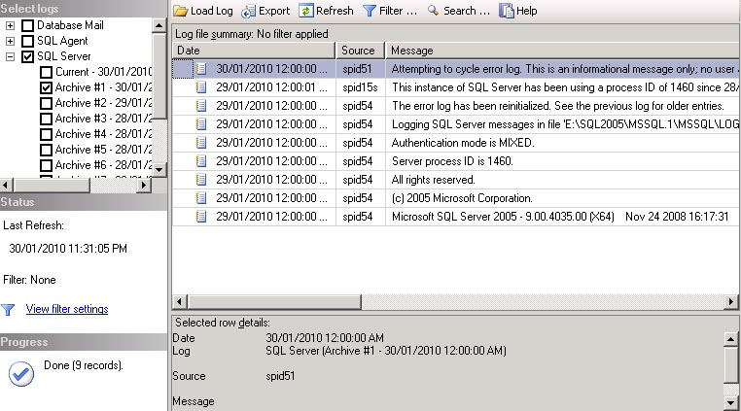
Log-Based Recovery
SQL Server
  a database file includes two file:X.mdf and X.ldf
  X.ldf is a log file

Slide 12
Log-Based Recovery
A log is kept on stable storage.
  The log is a sequence of log records, and maintains a record of update activities on the database.
When transaction T_{i} starts, it registers itself by writing a
<T_{i} start> log record
Before T_{i} executes write(X), a log record <T_{i}, X_{j} , V₁, V₂> is written, where V₁ is the value of X_{j} before the write, and V₂ is the value to be written to X_{j} .
  Log record notes that T_{i} has performed a write on data item X_{j} , X_{j} had value V₁ before the write, and will have value V₂ after the write.

Slide 13
Log-Based Recovery
When T_{i} finishes it last statement, the log record <T_{i} commit> is written.
We assume for now that log records are written directly to stable storage (that is, they are not buffered)
Two approaches using logs
  Deferred database modification
  Immediate database modification

Slide 14
Deferred Database Modification
The deferred database modification scheme records all modifications to the log, but defers all the writes to after partial commit.
Assume that transactions execute serially
Transaction starts by writing <T_{i} start> record to log.
A write(X) operation results in a log record <T_{i}, X, V> being written, where V is the new value for X
  Note: old value is not needed for this scheme
The write is not performed on X at this time, but is deferred.
When T_{i} partially commits, <T_{i} commit> is written to the log
Finally, the log records are read and used to actually execute the previously deferred writes.

Slide 15
Deferred Database Modification (Cont.)
During recovery after a crash, a transaction needs to be redone if and only if both <T_{i} start> and <T_{i} commit> are there in the log.
Redoing a transaction T_{i} ( redo T_{i}) sets the value of all data items updated by the transaction to the new values.
example transactions T₀ and T₁ (T₀ executes before T₁):
T₀: read (A) T₁ : read (C)
A := A - 50 C := C- 100
Write (A) write (C)
read (B)
B := B + 50
write (B)
Initial: A=1000 B=2000 C=700

Slide 16

Deferred Database Modification (Cont.)
Below we show the log as it appears at three instances of time.
If log on stable storage at time of crash is as in case:
(a) No redo actions need to be taken
(b) redo(T₀) must be performed since <T₀ commit> is present
(c) redo(T₀) must be performed followed by redo(T₁) since
<T₀ commit> and <T_{i} commit> are present

Slide 17
Immediate Database Modification
The immediate database modification scheme allows database updates of an uncommitted transaction to be made as the writes are issued
  since undoing may be needed, update logs must have both old value and new value
Update log record must be written before database item is written
  We assume that the log record is output directly to stable storage
  Can be extended to postpone log record output, so long as prior to execution of an output(B) operation for a data block B, all log records corresponding to items B must be flushed to stable storage
Output of updated blocks can take place at any time before or after transaction commit
Order in which blocks are output can be different from the order in which they are written.

Slide 18
Immediate Database Modification Example
Log Write Output
<T₀ start>
<T₀, A, 1000, 950>
<T₀, B, 2000, 2050>
A = 950
B = 2050
<T₀ commit>
<T₁ start>
<T₁, C, 700, 600>
C = 600
B_{B}, B_{C}
<T₁ commit>
B_{A}
Note: B_{X} denotes block containing X.

Slide 19
Immediate Database Modification (Cont.)
Recovery procedure has two operations instead of one:
  undo(T_{i}) restores the value of all data items updated by T_{i} to their old values, going backwards from the last log record for T_{i}
  redo(T_{i}) sets the value of all data items updated by T_{i} to the new values, going forward from the first log record for T_{i}
Both operations must be idempotent(幂等的)
  That is, even if the operation is executed multiple times the effect is the same as if it is executed once
    Needed since operations may get re-executed during recovery
When recovering after failure:
  Transaction T_{i} needs to be undone if the log contains the record
  <T_{i} start>, but does not contain the record <T_{i} commit>.
  Transaction T_{i} needs to be redone if the log contains both the record <T_{i} start> and the record <T_{i} commit>.
Undo operations are performed first, then redo operations.

Slide 20

Immediate DB Modification Recovery Example
Below we show the log as it appears at three instances of time.
Recovery actions in each case above are:
(a) undo (T₀): B is restored to 2000 and A to 1000.
(b) undo (T₁) and redo (T₀): C is restored to 700, and then A and B are
set to 950 and 2050 respectively.
(c) redo (T₀) and redo (T₁): A and B are set to 950 and 2050
respectively. Then C is set to 600

Slide 21
Checkpoints
Problems in recovery procedure as discussed earlier :
  searching the entire log is time-consuming
  we might unnecessarily redo transactions which have already
  output their updates to the database.
Streamline recovery procedure by periodically performing checkpointing
  Output all log records currently residing in main memory onto stable storage.
  Output all modified buffer blocks to the disk.
  Write a log record < checkpoint> onto stable storage.

Slide 22
Checkpoints (Cont.)
During recovery we need to consider only the most recent transaction T_{i} that started before the checkpoint, and transactions that started after T_{i}.
  Scan backwards from end of log to find the most recent <checkpoint> record
  Continue scanning backwards till a record <T_{i} start> is found.
  Need only consider the part of log following above start record. Earlier part of log can be ignored during recovery, and can be erased whenever desired.
  For all transactions (starting from T_{i} or later) with no <T_{i} commit>, execute undo(T_{i}). (Done only in case of immediate modification.)
  Scanning forward in the log, for all transactions starting from T_{i} or later with a <T_{i} commit>, execute redo(T_{i}).

Slide 23
Example of Checkpoints
T₁ can be ignored (updates already output to disk due to checkpoint)
T₂ and T₃ redone.
T₄ undone
T_{c}
T_{f}
T₁
T₂
T₃
T₄
checkpoint
system failure

Slide 24
Recovery With Concurrent Transactions
We modify the log-based recovery schemes to allow multiple transactions to execute concurrently.
  All transactions share a single disk buffer and a single log
  A buffer block can have data items updated by one or more transactions
We assume concurrency control using strict two-phase locking;
  i.e. the updates of uncommitted transactions should not be visible to other transactions
    Otherwise how to perform undo if T1 updates A, then T2 updates A and commits, and finally T1 has to abort?
Logging is done as described earlier.
  Log records of different transactions may be interspersed in the log.
The checkpointing technique and actions taken on recovery have to be changed
  since several transactions may be active when a checkpoint is performed.

Slide 25
Recovery With Concurrent Transactions (Cont.)
Checkpoints are performed as before, except that the checkpoint log record is now of the form
< checkpoint L>
where L is the list of transactions active at the time of the checkpoint
  We assume no updates are in progress while the checkpoint is carried out (will relax this later)
When the system recovers from a crash, it first does the following:
  Initialize undo-list and redo-list to empty
  Scan the log backwards from the end, stopping when the first <checkpoint L> record is found.
  For each record found during the backward scan:
    if the record is <T_{i} commit>, add T_{i} to redo-list
    if the record is <T_{i} start>, then if T_{i} is not in redo-list, add T_{i} to undo-list
  For every T_{i} in L, if T_{i} is not in redo-list, add T_{i} to undo-list

Slide 26
Recovery With Concurrent Transactions (Cont.)
At this point undo-list consists of incomplete transactions which must be undone, and redo-list consists of finished transactions that must be redone.
Recovery now continues as follows:
  Scan log backwards from most recent record, stopping when
  <T_{i} start> records have been encountered for every T_{i} in undo-list.
    During the scan, perform undo for each log record that belongs to a transaction in undo-list.
  Locate the most recent <checkpoint L> record.
  Scan log forwards from the <checkpoint L> record till the end of the log.
    During the scan, perform redo for each log record that belongs to a transaction on redo-list

Slide 27
Example of Recovery
Go over the steps of the recovery algorithm on the following log:
        <T₀ start>
        <T₀, A, 0, 10>
        <T₀ commit>
        <T₁ start> /* Scan at step 1 comes up to here */
        <T₁, B, 0, 10>
        <T₂ start>
        <T₂, C, 0, 10>
        <T₂, C, 10, 20>
        <checkpoint {T₁, T₂}>
        <T₃ start>
        <T₃, A, 10, 20>
        <T₃, D, 0, 10>
        <T₃ commit>
undo T1
undo T2
redo-list:
T₃
undo-list:
T₂
T₁
redo T3
(3)
(2)
(1)

Slide 28
Log Record Buffering
Log record buffering: log records are buffered in main memory, instead of of being output directly to stable storage.
  Log records are output to stable storage when a block of log records in the buffer is full, or a log force operation is executed.
Log force is performed to commit a transaction by forcing all its log records (including the commit record) to stable storage.
Several log records can thus be output using a single output operation, reducing the I/O cost.

Slide 29
Log Record Buffering (Cont.)
The rules below must be followed if log records are buffered:
  Log records are output to stable storage in the order in which they are created.
  Transaction T_{i} enters the commit state only when the log record
  <T_{i} commit> has been output to stable storage.
  Before a block of data in main memory is output to the database, all log records pertaining to data in that block must have been output to stable storage.
    This rule is called the write-ahead logging or WAL rule
      Strictly speaking WAL only requires undo information to be output

Slide 30
Database Buffering
Database maintains an in-memory buffer of data blocks
  When a new block is needed, if buffer is full an existing block needs to be removed from buffer
  If the block chosen for removal has been updated, it must be output to disk
If a block with uncommitted updates is output to disk, log records with undo information for the updates are output to the log on stable storage first
  (Write ahead logging)

Slide 31
Example of WAL
Log Descriptions
<T₀ start>
<T₀, A, 1000, 950>
<T₀, B, 2000, 2050>
<T₀ commit>
<T₁ start>
<T₁, C, 700, 600>
<T₁ commit>
Assume that the block_{B} is not in main memory, and that main memory is full. Suppose that block_{A} is chosen to be output to the disk. According WAL requirement, the log record <T0, A, 1000, 950> must be output to the stable storage firstly

Slide 32
Database Buffering
No updates should be in progress on a block when it is output to disk. Can be ensured as follows.
  Before writing a data item, transaction acquires exclusive lock on block containing the data item
  Lock can be released once the write is completed.
    Such locks held for short duration are called latches.
  Before a block is output to disk, the system acquires an exclusive latch on the block
    Ensures no update can be in progress on the block

Slide 33
Buffer Management (Cont.)
Database buffer can be implemented either
  in an area of real main-memory reserved for the database, or
  in virtual memory
Database buffers are generally implemented in virtual memory

Slide 34
Failure with Loss of Nonvolatile Storage
So far we assumed no loss of non-volatile storage
Technique similar to checkpointing used to deal with loss of non-volatile storage
  Periodically dump the entire content of the database to stable storage
  No transaction may be active during the dump procedure; a procedure similar to checkpointing must take place
    Output all log records currently residing in main memory onto stable storage.
    Output all buffer blocks onto the disk.
    Copy the contents of the database to stable storage.
    Output a record <dump> to log on stable storage.

Slide 35
Recovering from Failure of Non-Volatile Storage
To recover from disk failure
  restore database from most recent dump.
  Consult the log and redo all transactions that committed after the dump
Can be extended to allow transactions to be active during dump;
known as fuzzy dump or online dump

Slide 36
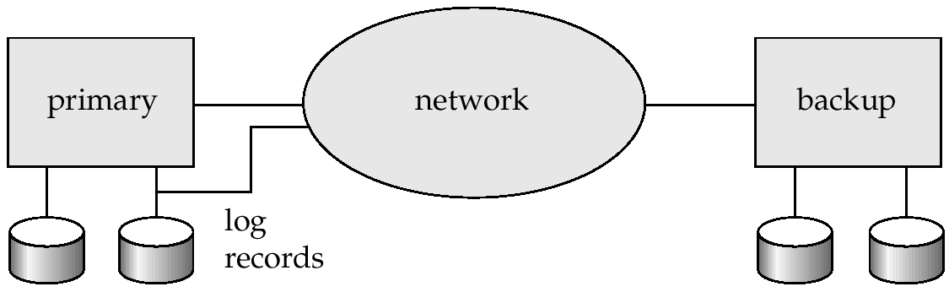
Remote Backup Systems
Remote backup systems provide high availability by allowing transaction processing to continue even if the primary site is destroyed.

Slide 37
End of Chapter

